Slide 1
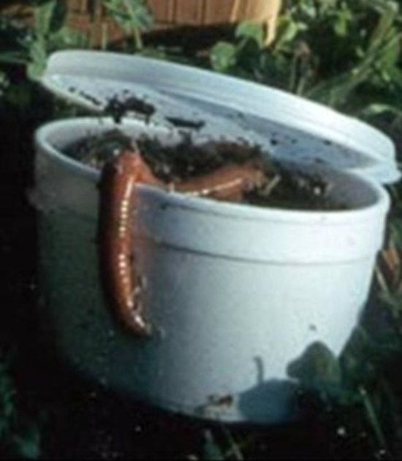
Amynthas Ante Portas: Forest Invasions by Asiatic Earthworms.
Earthworms As Agents of Change
Garden-variety earthworms are changing our forests

Slide 2
Number of earthworm species in Vermont
A total of 18 species have been reported
14 of European origin including some common composters
  Lumbricus rubellus (Red Worm)
  Eisenia foetida (Red Wigglers)
4 confirmed Asian species (thought to be subtropical and very destructive to our woods)
  Amynthas agrestis (Crazy Snake Worm)
  Amynthas tokiensis
  Amynthas hilgendorfi
  Perionyx excavatus (Blue Worm, only in composting)

Slide 3
How do you recognize these Asiatic earthworms?

Slide 4
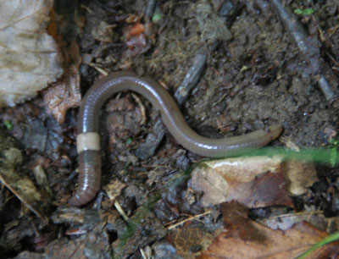
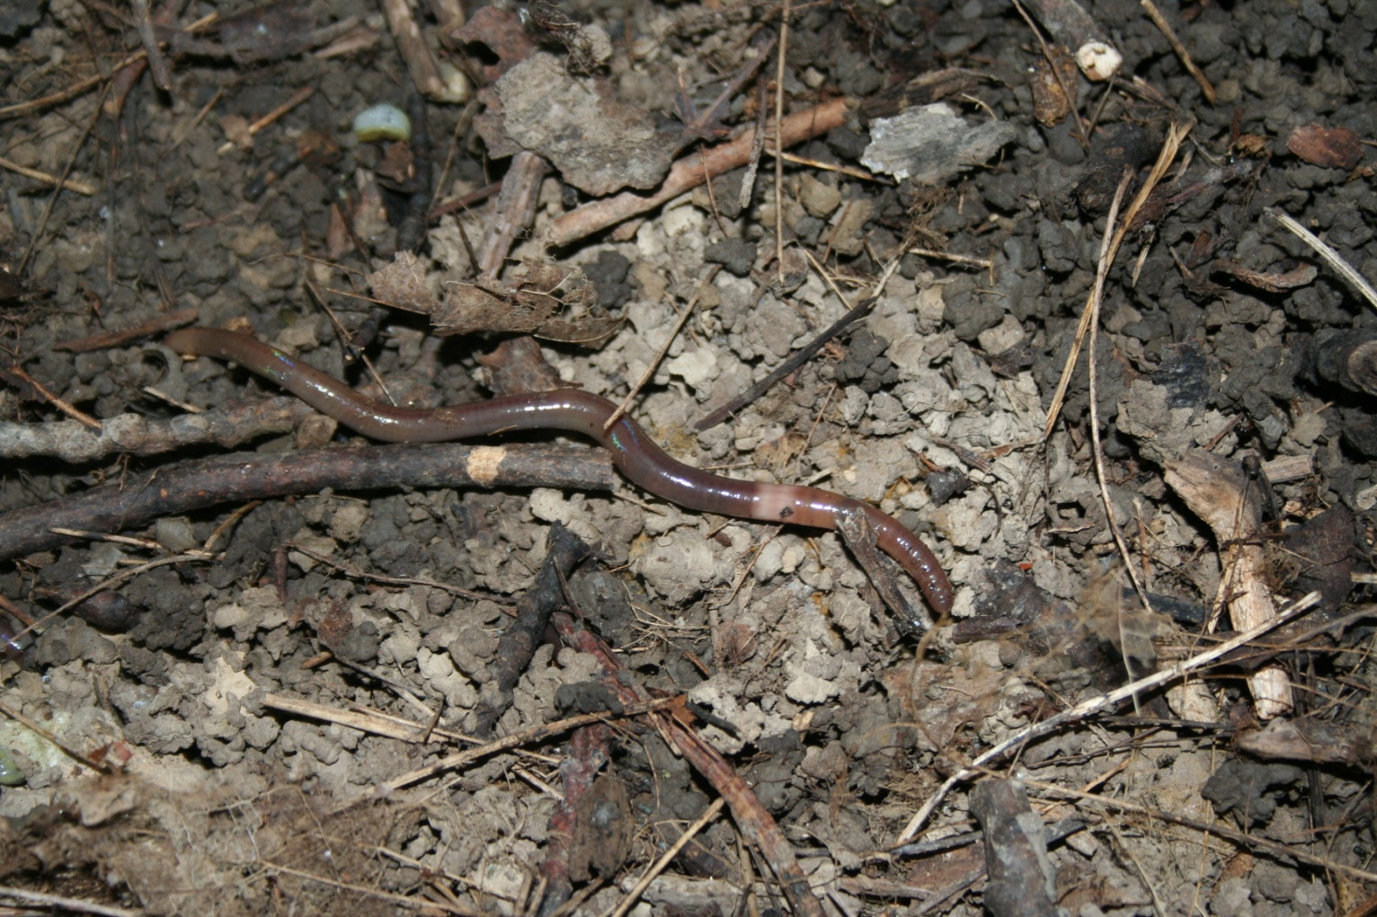
Amynthas agrestis Characteristics
Physical Characteristics
4 to 8 inches long
Darker dorsally than ventrally
Skin glossy with refractive properties
Light, smooth clitellum, all the way around body
Very active
Moves like a snake
Loses its tail when handled roughly
Is parthenogenic, “no sex please I am Amynthas”

Slide 5
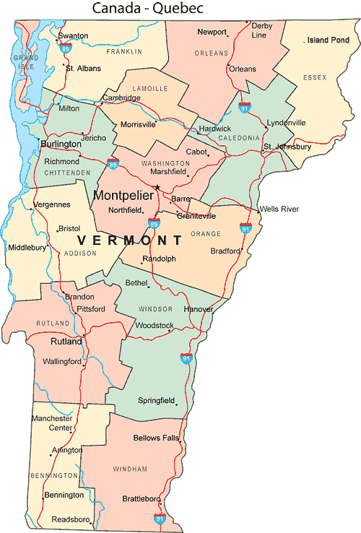

Where in Vermont do you find them?
My own observations
Woodlands,
Nurseries,
Gardens,
Compost piles
Hot Spots

Slide 6
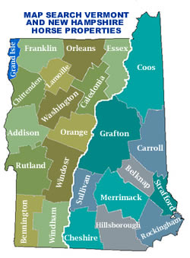
http://www.sethwarren.com/search_horse.php
Distribution of Amynthas
in NH and VT by county,
Survey of Master Gardeners
Hotspots appear to be near Burlington Vermont
AND
Upper Connecticut Valley around Hanover, NH, and Norwich, VT

Slide 7
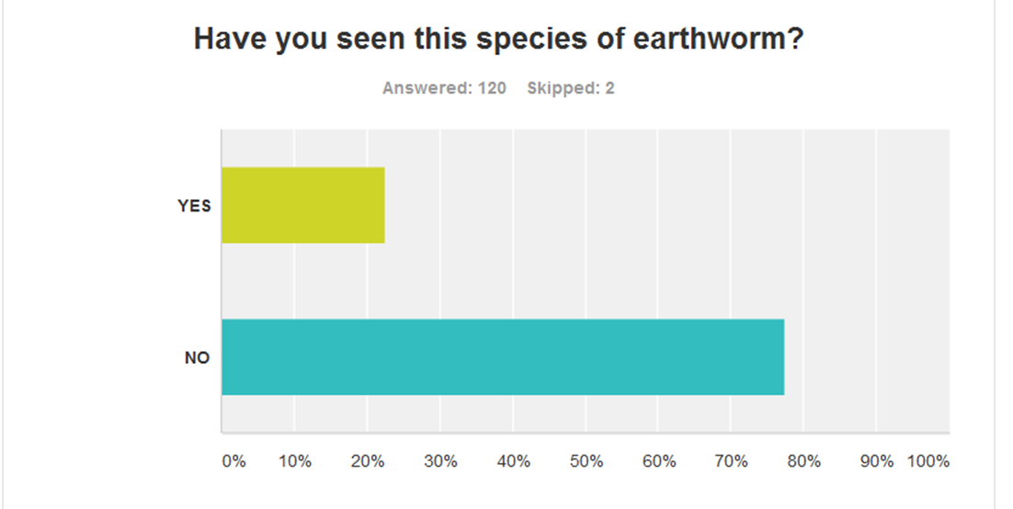
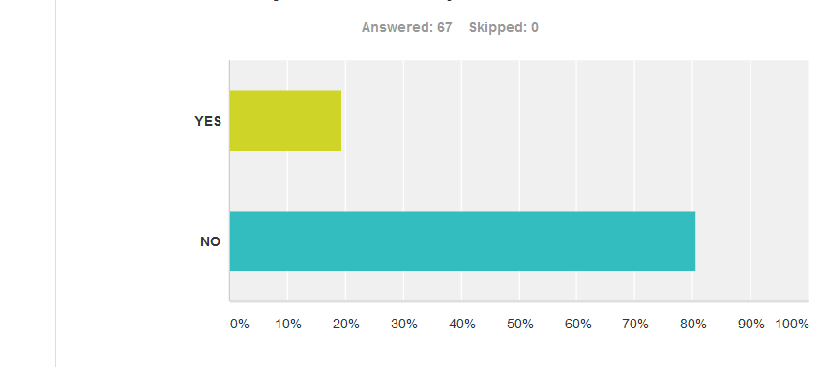
Vermont
New Hampshire

Slide 8
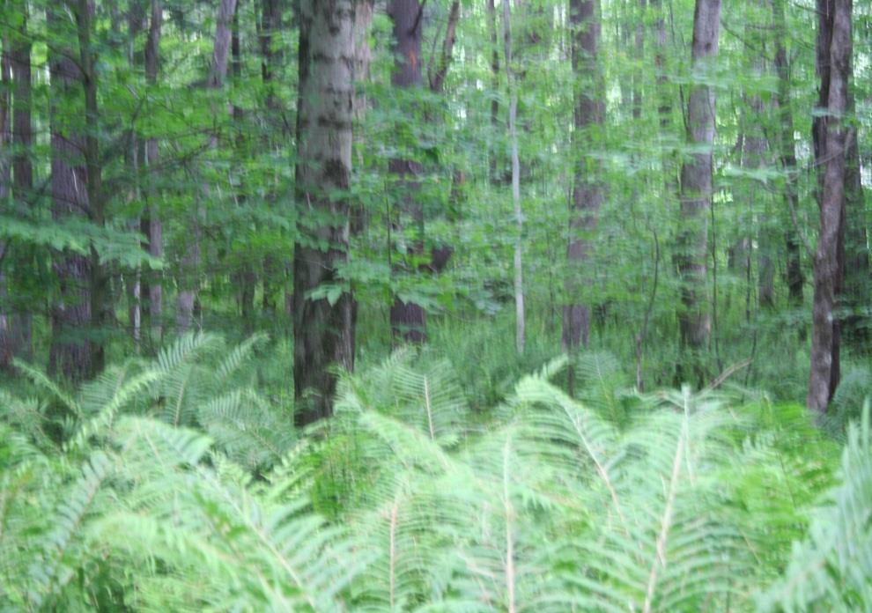
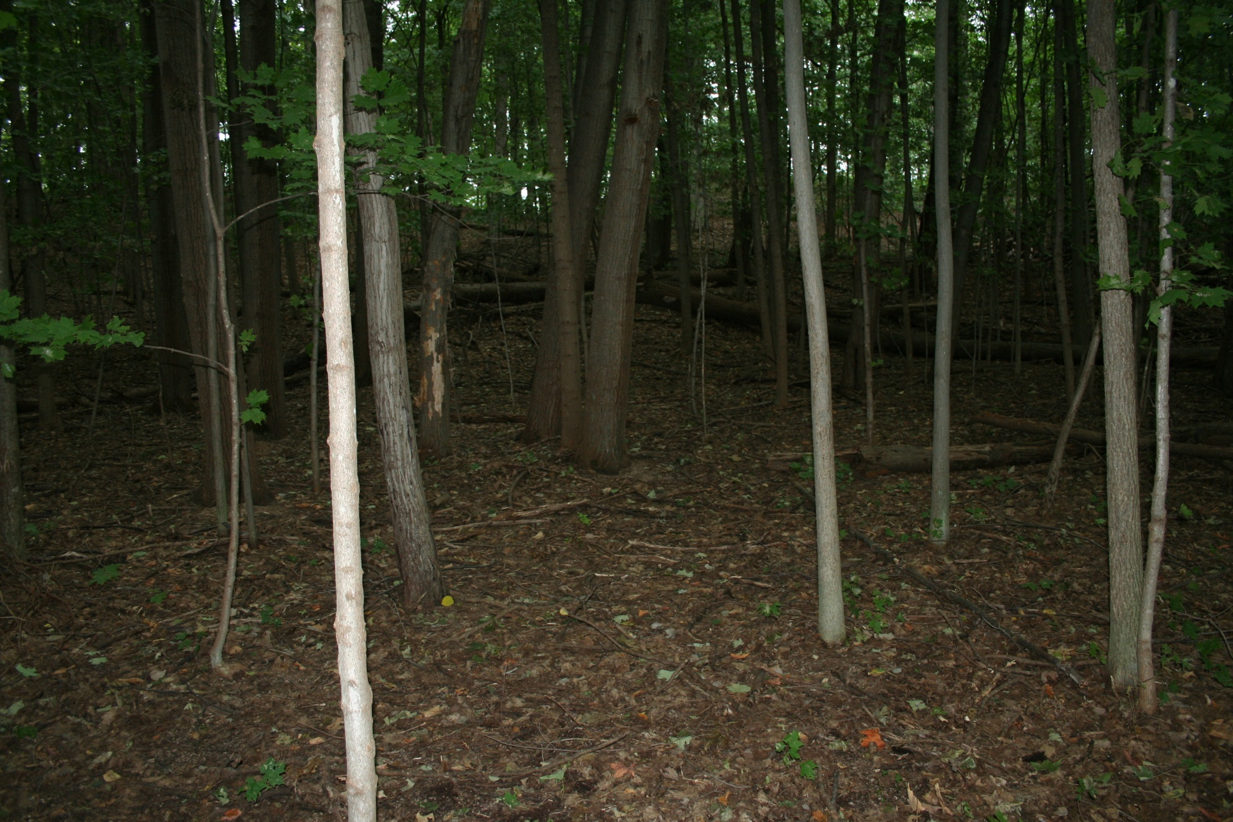
Net Effect on Vegetation
No earthworms
Forest invaded by Amynthas

Slide 9

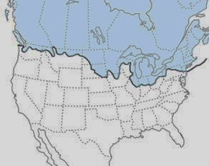

Chain of events began with
the last ice age
Earthworm-Free Zone
Soil as Ballast
Now World Trade
Ice age killed earthworms north of
reach of glaciers
Map Image credit: http://www.nrri.umn.edu/worms/forest/index.html
Ship image sourcehttp://colonial.phillipmartin.info/colonial_america_colonial_ship.html

Slide 10
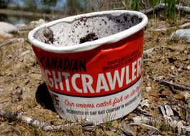
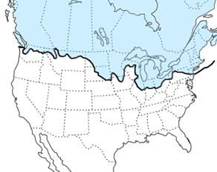
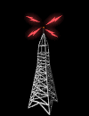
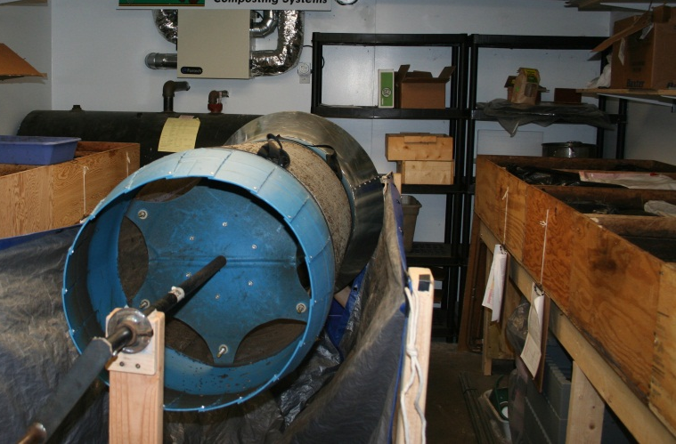
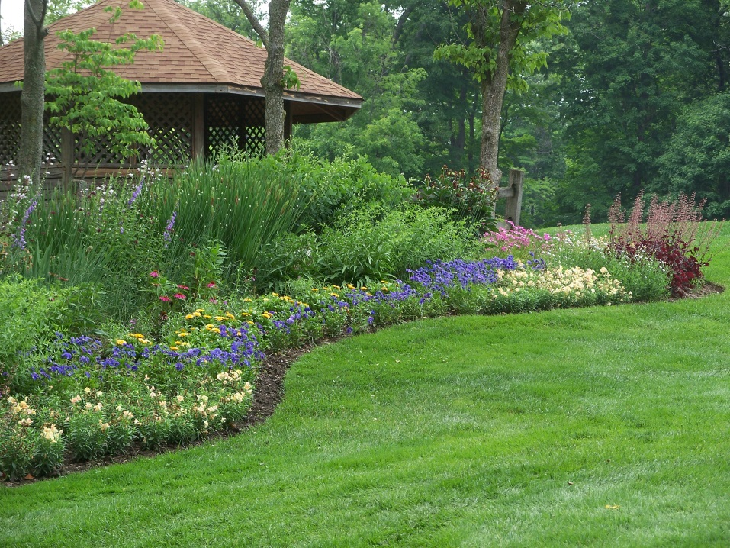
http://coloradoflyfishingreports.blogspot.com/2011/09/bait-dunkers-found-your-spot.html
Extent of Last Glaciation
Almost exclusively
exotic worms
European and Asian species competing with
native earthworms
AGENTS of DISPERSAL
Signal from http://www.20thcenturyradio.com/

Slide 11
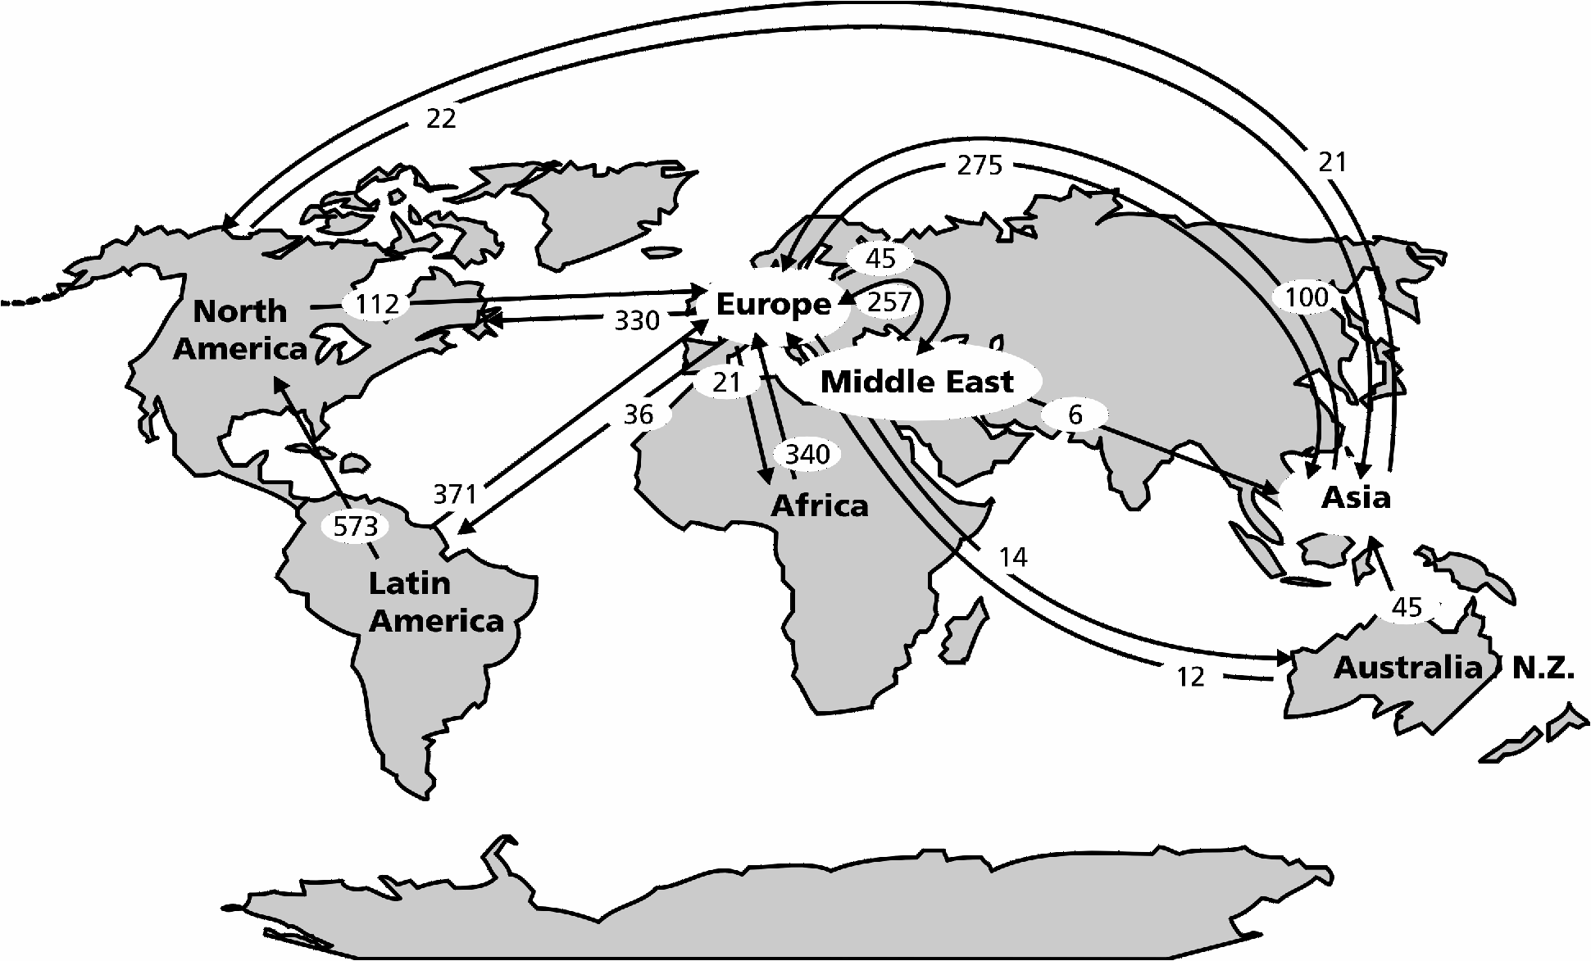
Horticulture Trade
http://www.agrsci.unibo.it/wchr/wc1/degroot.html

Slide 12
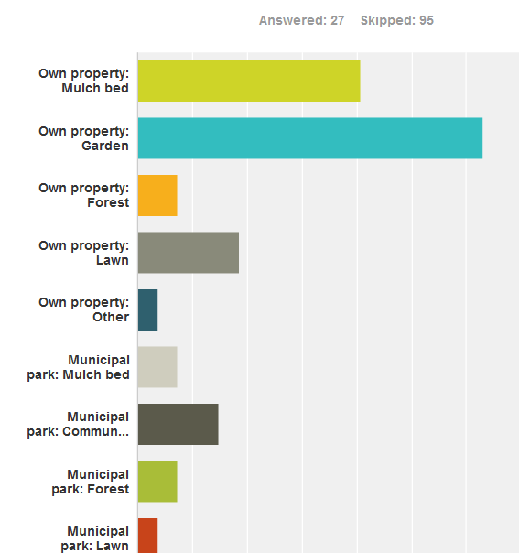
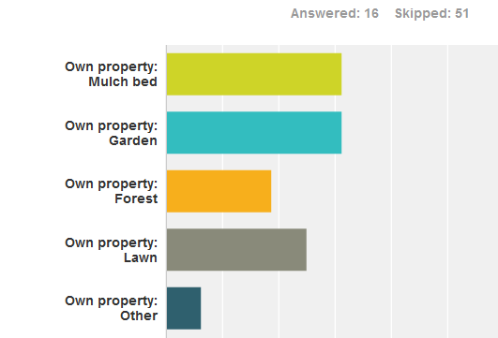
Horticultural Settings: Master Gardener Survey
Where have you seen this earthworm?
50%
50%
New Hampshire
Vermont
Yes, they are in Vermont, even though they are deemed exotic.

Slide 13
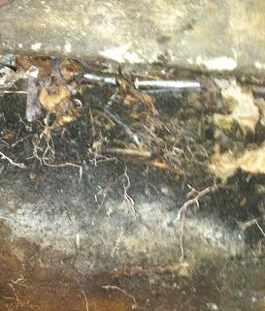
Consequence of Ice Age and Absence of Earthworms
Because of the lack of earthworms after the glaciers receded, a thick layer of organic material accumulated
This layer is a seed bank
Germination medium
Water filter
Great Resource for Earthworms
Picture by Justin Richardson of Dartmouth College

Slide 14
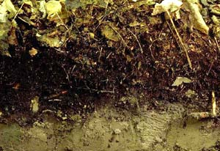
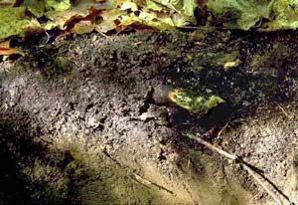
Effect of Earthworms on Forest Soil Structure
Before Invasion
After Invasion
Mor-type (duff) forest
floor: Seed bank and
germination medium
Mull-type forest floor
Dense A -horizon
Picture credit: http://www.nrri.umn.edu/worms/forest/soil.html

Slide 15
Degree of Infestation and Forest Damage
Invasive Earthworm Rapid Assessment Tool
Impact class | O-horizons | Roots/Fungi in forest floor | Castings | Earthworms
1. E/worm free | Oi, Oe,Oa present | Present | Not present | none
2. Minimal | Oi, Oe, present Oa patchy | present , but not abundant | Mixing of Oa/mineral, no large castings at surface | A few small epigeic worms
3. Moderate | Oi is present, Oe reduced, Oa absent | absent | Less than 50% of top soil are castings | Small epi and epi-endogeic earthworms
4. Substantial | Oi present but lost by late summer early fall, bare mineral soil | absent | Abundant, and few large casting mounts; >50% of top soil | All eco-groups present
5. Heavy | Oi gone by mid-summer/bare mineral soil | absent | Castings and large castings abundant | L.terrestris, others

Slide 16
When Do You See This Earthworm?
Annual, Summer-Active, Winter-Killed

Slide 17
Love to hear from you when you see them… jgorres@umv.edu
Where did you see tem?
What ecological setting were they in?
How many did you see?
How large were these worms?

